Slide 1

How does deep learning work?

Slide 2
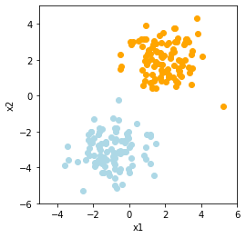
Linear models
Logistic regression is a classification model
We can separate two classes using a linear decision boundary
For new data points, we want to predict the probability of the point belonging to class 1 or 2.
Example: cancer vs non-cancer diagnosis

Slide 3
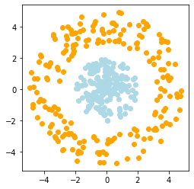
Non-linearly separable classes
What would happen if we apply logistic regression to this data?

Slide 4
Non-linearly separable classes
What would happen if we apply logistic regression to this data?
→ Not possible, the task is too complex !

Slide 5
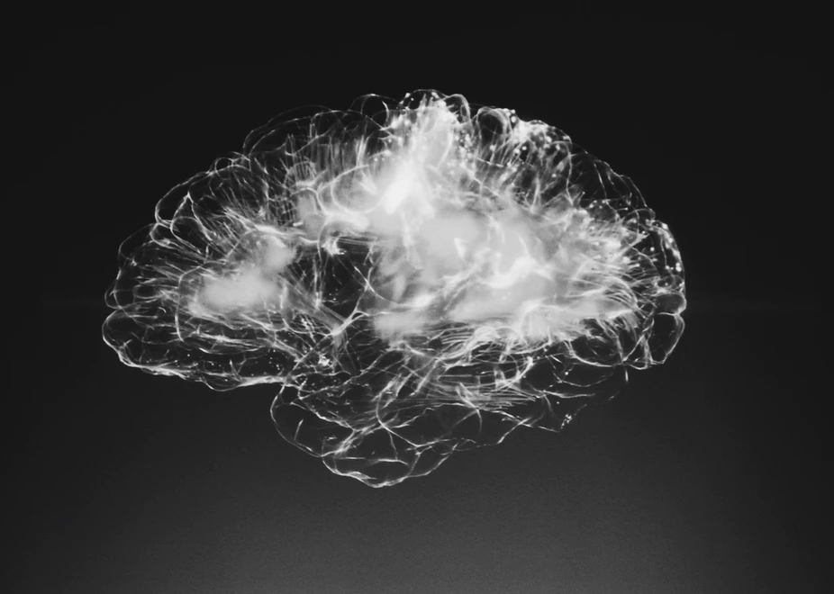
What if we try to imitate human brain
The brain processes information by having billions of interconnected neurons
Many simple interactions can solve complex tasks
Can we translate this concept to teach a computer to learn complex patterns ?

Slide 6
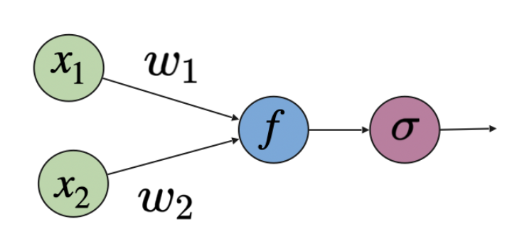
Computational model of a single neuron
Inputs x1, x2 are multiplied with weights w1, w2 and added together, and a bias b is added
We then apply an activation function: for classification this is the sigmoid function (“squeezes” the output between 0 and 1)

Slide 7
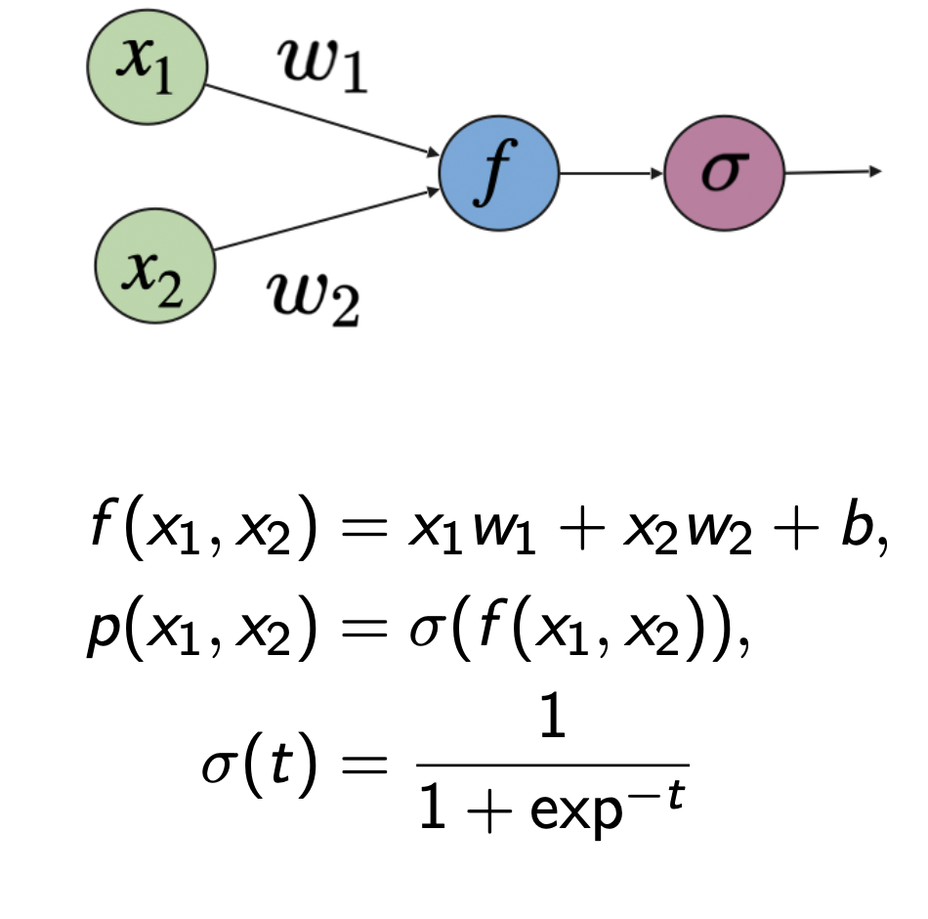
Computational model of a single neuron
Does it remind you of anything?

Slide 8
Computational model of a single neuron
Does it remind you of anything?
Logistic regression!

Slide 9
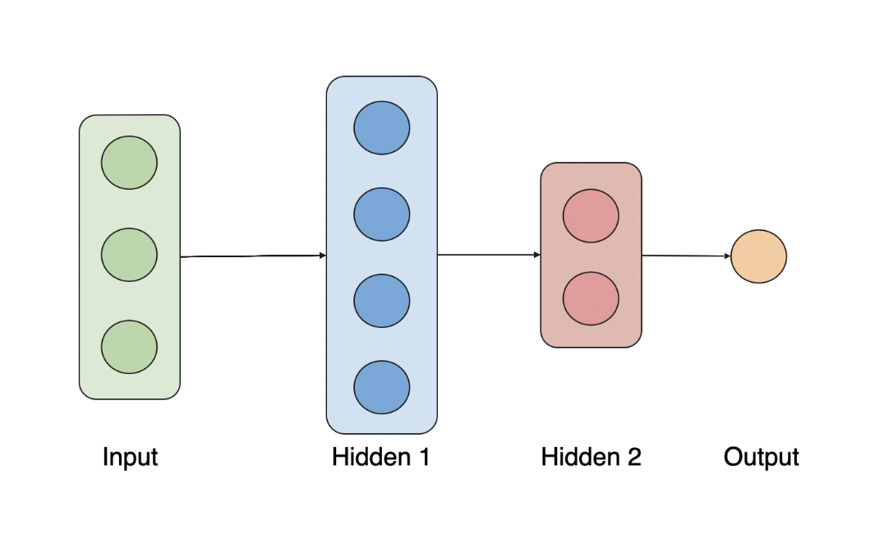
A neural network
A neural network connects many individual neurons (nodes) together to solve complex tasks.
The architecture of a neural network tells us how these connections should look like.

Slide 10
A neural network
The input layer consists of data - predictors, also called features.
The output layer is the observed variable of interest.
In-between are the hidden layers.

Slide 11


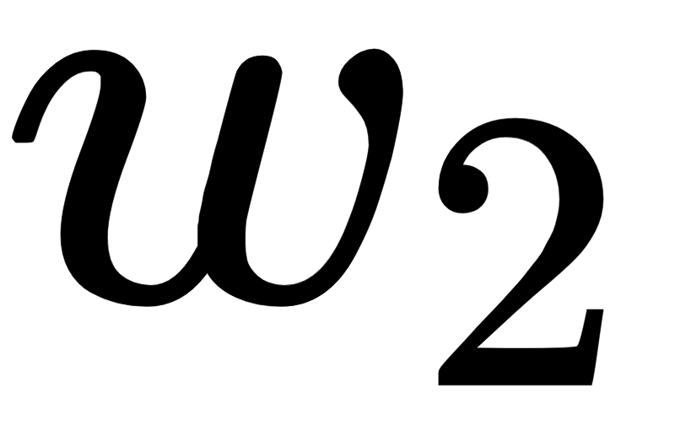
A single neuron fails
x
f
y

Slide 12
How can a network separate the classes?

Slide 13
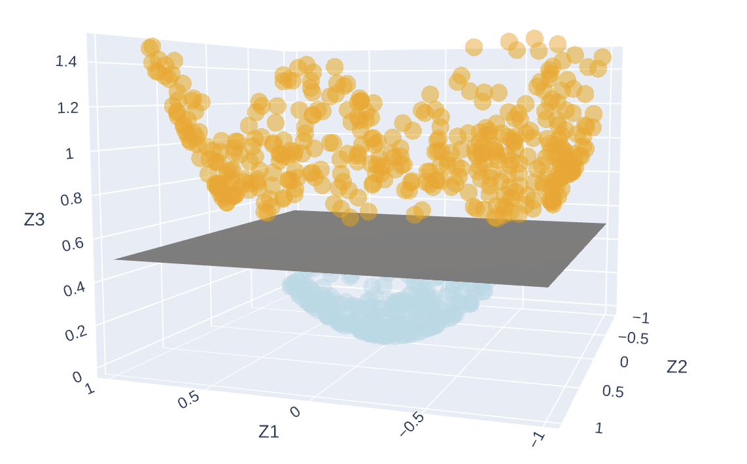
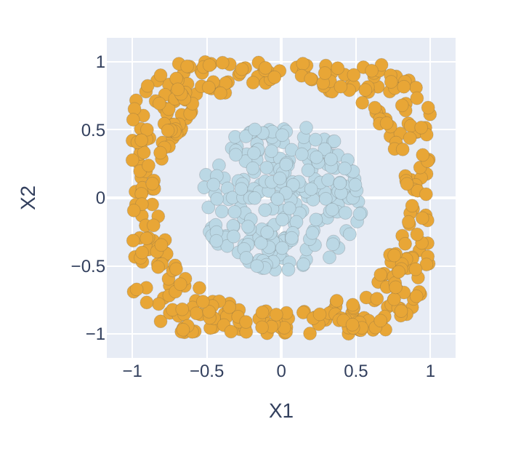
Representation learning
Φ
Φ⁻¹
Φ = x₁x₁ + x₂x₂

Slide 14
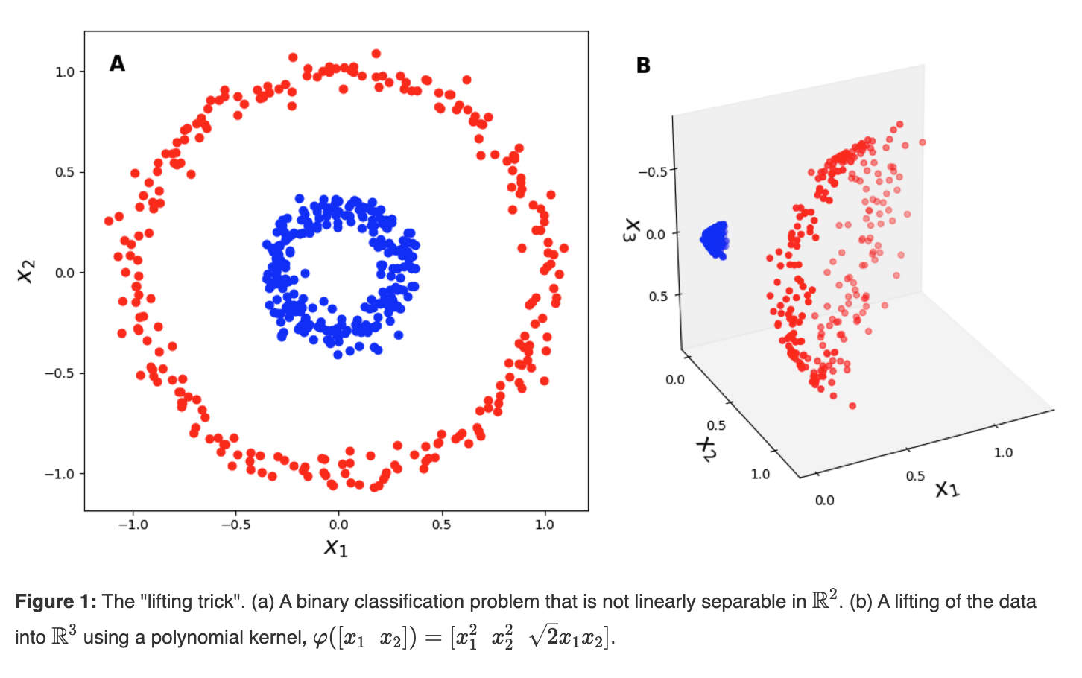
The kernel trick
The layers of a network map the input data to higher dimensional space
In this final representation the classes can then be separated by a plane
https://gregorygundersen.com/blog/2019/12/10/kernel-trick/

Slide 15
A neural network: representation learning
The first part of our network represents the input in higher dimensional space, we call this representation learning or feature extraction
In the last layer of our network, logistic regression is applied to obtain the output “probabilities”
Representation Learning
Logistic Regression

Slide 16
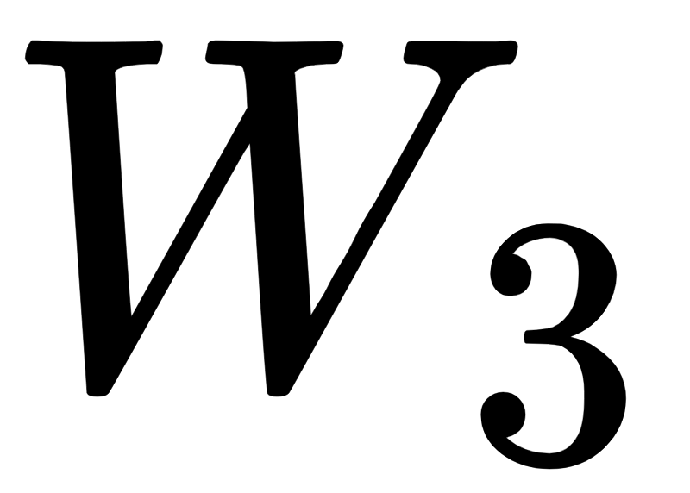

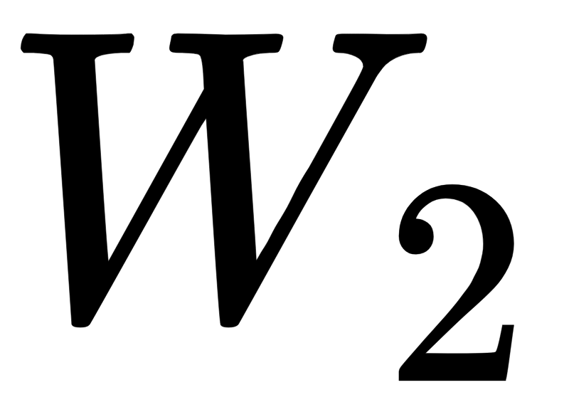
What does learning mean?
Learning in a neural network means finding “good” (optimal) weights of the connections between the various neurons.
We can learn these weights from our training data.

Slide 17
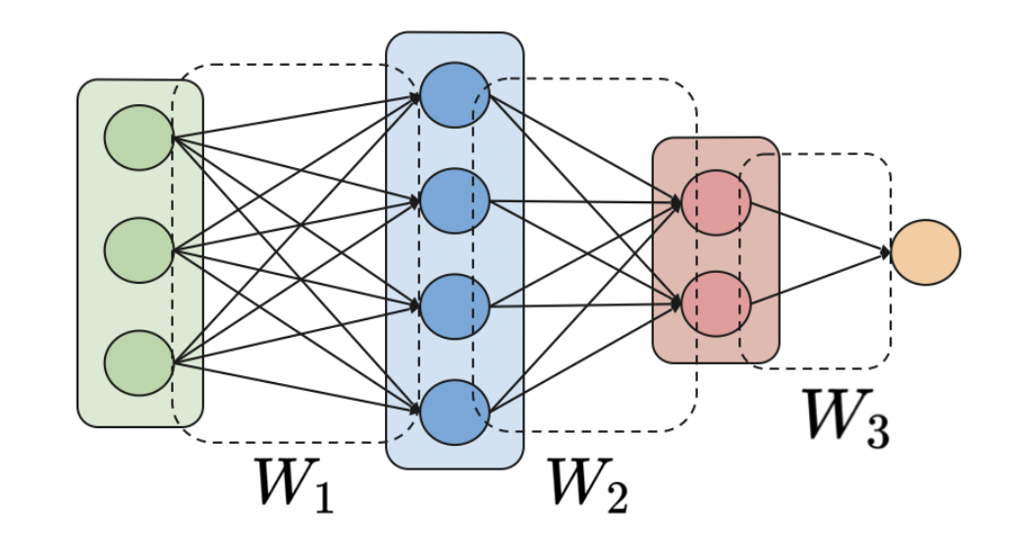
Network design
We refer to the design of the network as the network architecture:
The number of hidden layers,
The number of neurons per layer (referred to as width),
The activation function for each neuron.

Slide 18
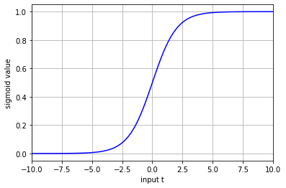
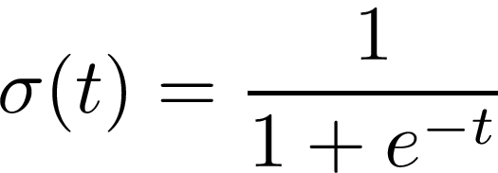
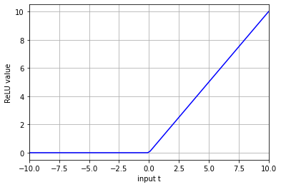
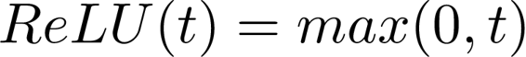
Activation functions
Sigmoid
Every node in the network has an activation function, which is a non-linear transformation
To perform binary classification, our last node has a sigmoid activation
Squeezes the output between 0 and 1
For nodes in the hidden layers we usually apply the Rectified Linear Unit (ReLU)
ReLU

Slide 19

Training a Neural Network
As with logistic regression we need a loss function
Binary cross-entropy is well suitable for binary classification
We want to find weights that minimize this loss function
We can use gradient descent to iteratively update our weights to get the best loss value
By taking the gradient of our loss function we can determine the direction of the step
Our step size is determined by the learning rate
Loss

Slide 20
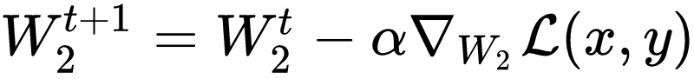
Back propagation
How can we update the hidden layers based on the loss value determined from the last layer?
We can still apply gradient descent, but we take the gradient with respect to the weights of the layers we want to update
These derivatives can be obtained by the chain rule, iteratively going back from the last to the first layer, hence its name back propagation

Slide 21
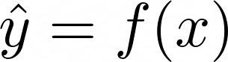
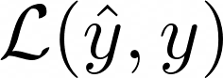

Forward Pass
Propagate (part of) your input data through the network to compute the predicted value
Compute the loss value between the prediction and the known ground-truth value
Forward Pass

Slide 22
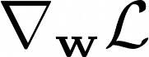
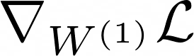
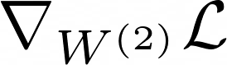
Backward Pass
Given the loss, compute the derivatives with respect to each layer of neurons (back-propagation)
Update the weights of each layer based on the computed gradients
Backward Pass

Slide 23

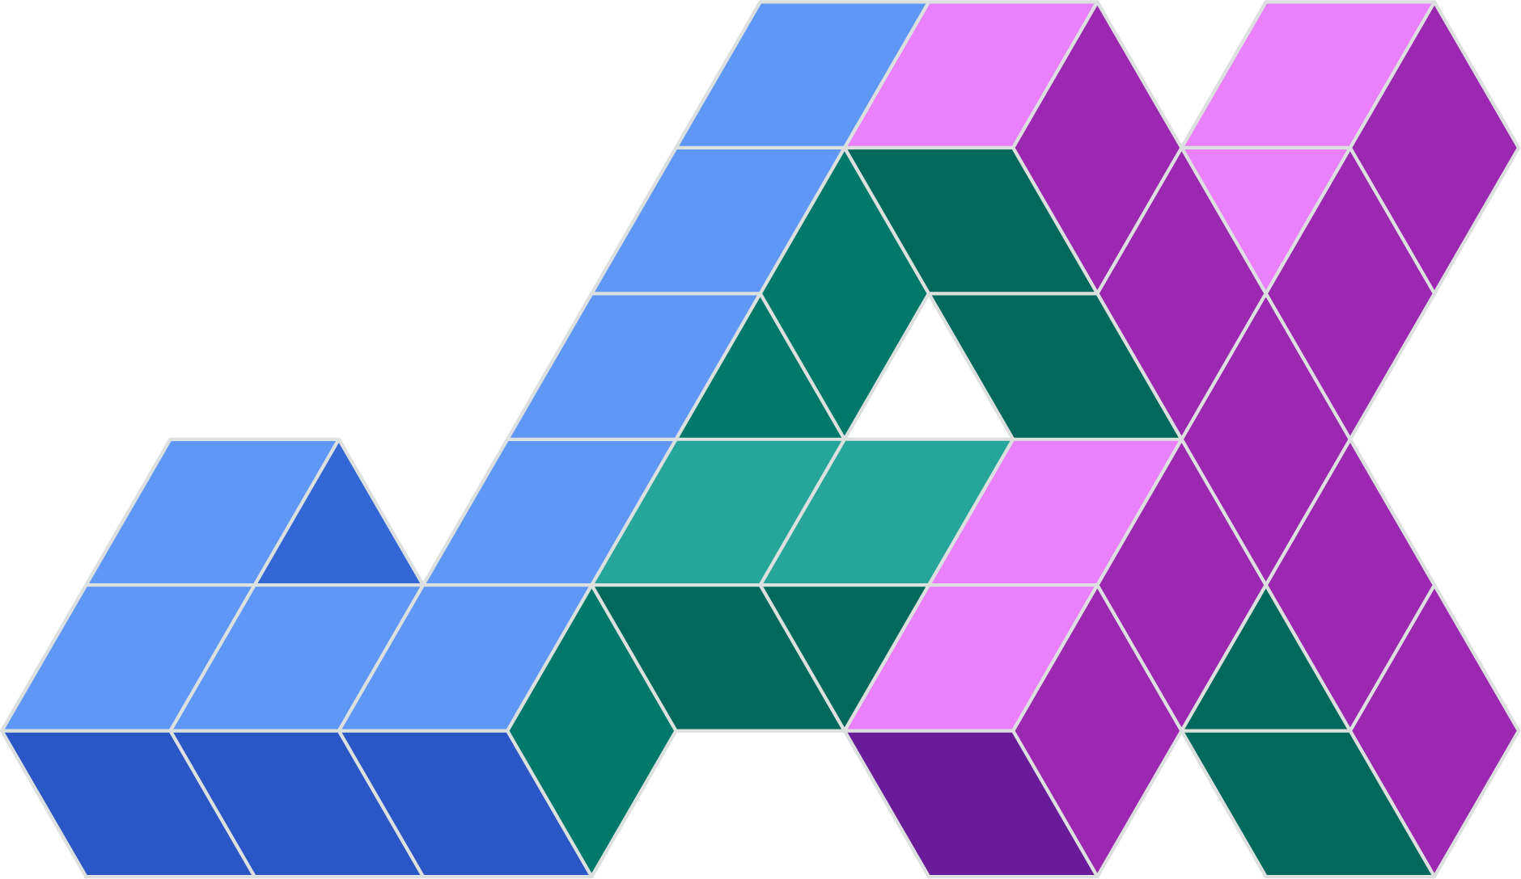

Implementation
Deep learning libraries implement the forward and backward passes automatically for you!
We just need to design an architecture, choose the hyperparameters (such as the learning rate), and implement the training loop

Slide 24
The training loop
Define the network
Load all training data into a tensor
For number of steps:
Give the data to the network to obtain a prediction
Compute the loss value
Perform back-propagation to obtain the gradients of the loss
Update the networks parameters (the weights) based on the gradient
Forward Pass
Backward Pass

Slide 25
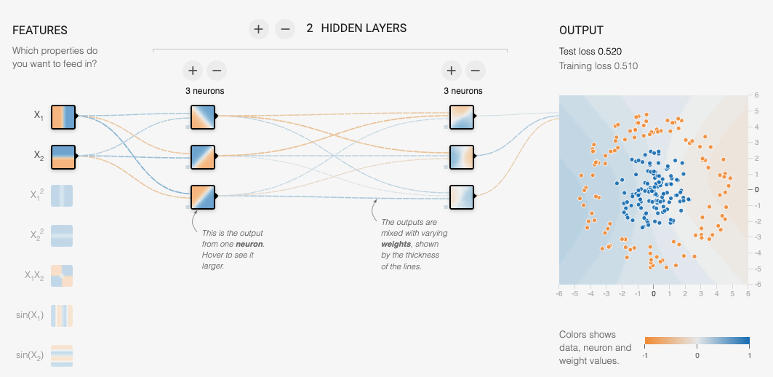
Try it for yourself
https://playground.tensorflow.org/

Slide 26
Mathematical foundations of deep learning
How to derive an appropriate loss function for each problem? Statistics
How to optimise a loss function? Calculus
How to express computations efficiently? Linear algebra

Slide 27
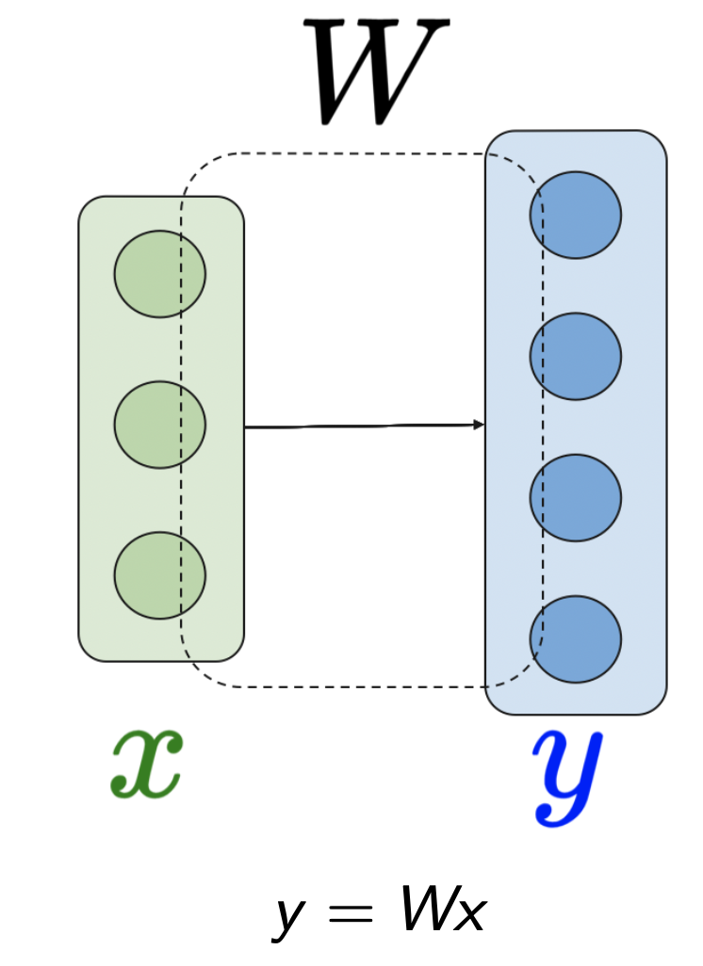
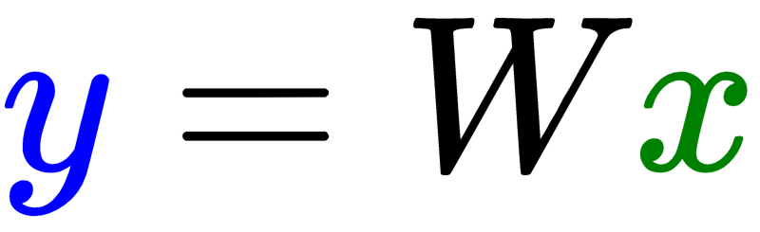

Neural networks in matrix notation

Slide 28
Architectures
The list of useful architectures is evolving daily as they are being discovered by trial-and-error.

Slide 29
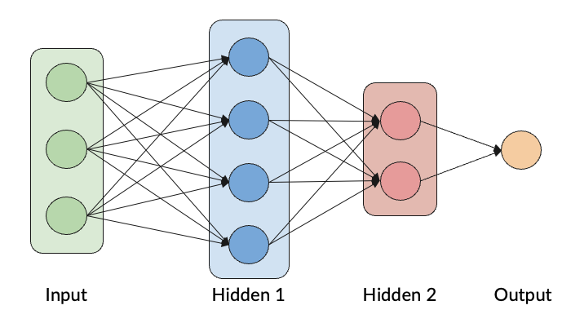
Multilayer perceptron (MLP)
A multi-layer perceptron (MLP) is a feedforward architecture, consisting of fully connected neurons with a nonlinear kind of activation function.

Slide 30
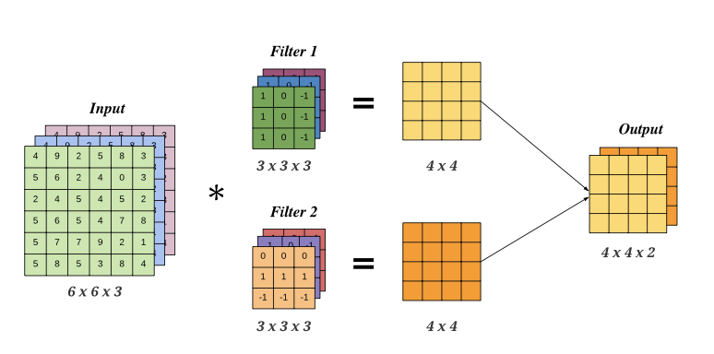
Convolutional neural networks (CNNs)
CNNs use convolutional layers which scan the input with a set of filters.
Pooling layers are used for downsampling.
Credit: Kevin Murphy, ”Probabilistic Machine Learning 2”

Slide 31
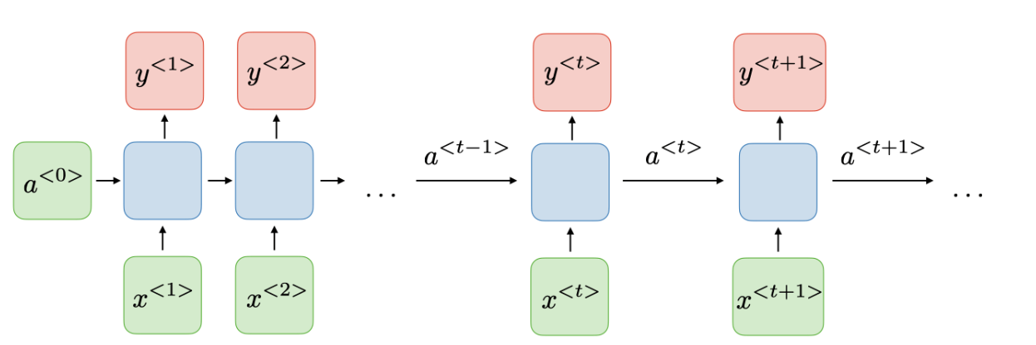
Recurrent neural networks (RNNs)
RNNs allow previous outputs to be used as inputs while having hidden states. They are used to model sequences.
Credit: Shervine Amidi, Stanford CS230 course

Slide 32
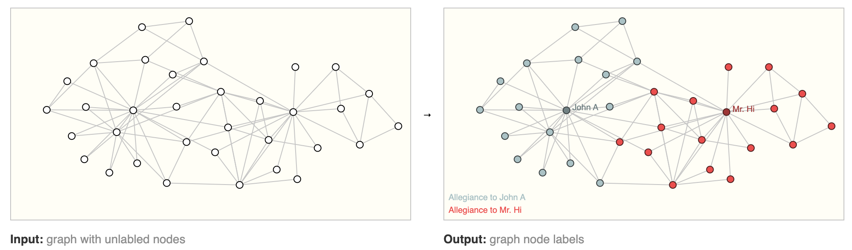
Graph neural networks (GNNs)
https://distill.pub/2021/gnn-intro/

Slide 33
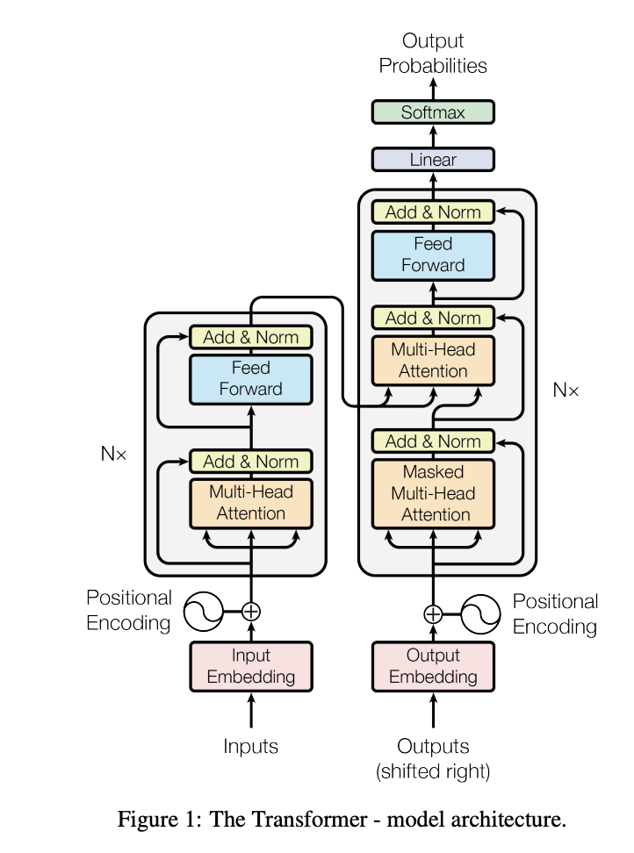
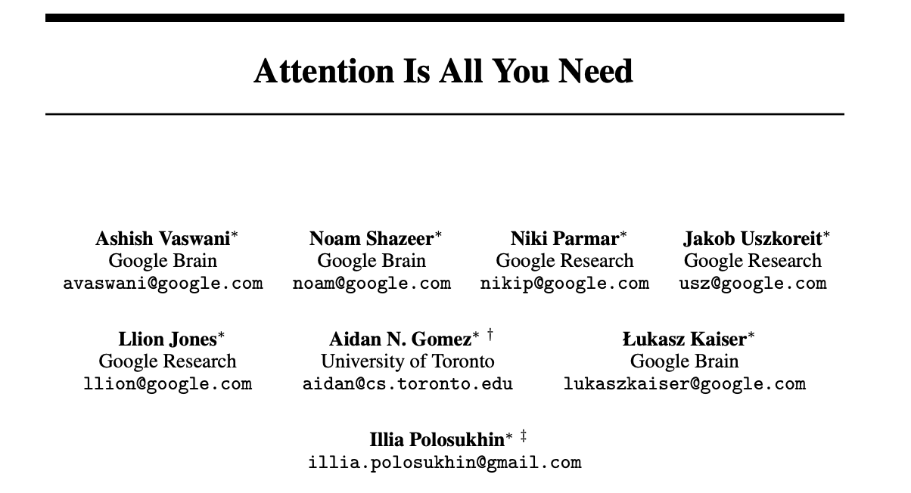
Transformer (2023!)

Slide 34

Transformer (2023!)
What does “GPT” stand for in “ChatGPT” ?

Slide 35
Transformer (2023!)
What does “GPT” stand for in “ChatGPT”?
ChatGPT = “Chat Generative Pre-trained Transformer”

Slide 36
How to succeed in this course?
Practice
Explore
Ask
Visualise

Slide 37
Glossary
AI
Machine learning
Neural network
ChatGPT
PyTorch, JAX, Keras, Tensorflow
CPU, GPU, TPU

Slide 38
Questions?

